Slide 1
Ultimate QC 1.0 Team Member: <Marcine Kelly> Product Owner: Rodrigo Morales Instructor: Masoud Sadjadi School of Computing and Information Sciences Florida International University
Senior Project Final Presentation Fall 2015
12/11/15
Notes:
Greet your audience, thank them for attending your presentation, introduce yourself, introduce your project, introduce your team members, and quickly indicate what each of you did in a high-level manner, and put more emphasis on your part/contribution.

Slide 2
Problem definition
Problem:
The current system for inspecting produce is a visual process.
Inspecting produce is a slow process.
QC inspectors examine crates of produce in a refrigerated environment for long periods of time.
This leads to:
miscounting produce, missing defective produce, etc.
My Part:
Alleviate some of the human error that can occur during the inspection process.
Help QC inspectors to reduce the time spent on the inspection process.
Project focus: blueberries, Produce Inspectors of America’s (PIA) main produce
How Ultimate QC works:
Inspector loads a blueberry image and the program analyzes the image.
Counts blueberries, identifies immature blueberries
Notes:
Introduce the problem that the whole project tackles and stay focused on the parts that you have been working. Indicate if there is an existing previous system, enumerate its problems/limitations, etc.

Slide 3
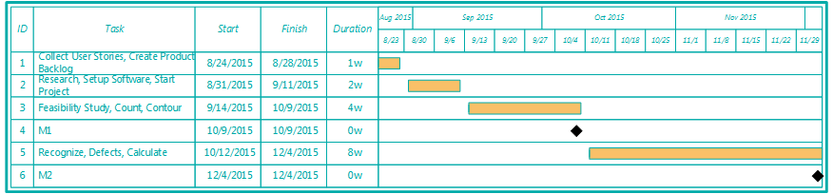
Project Management
Notes:
Project Management (schedule for entire semester) (one slide; Gantt Chart).

Slide 4
Requirements: User Stories
Notes:
4. Requirements:
4.1. User stories implemented (one or more slides).
4.2. UML use cases and the use case diagram for the implemented use cases (one or more slides).
4.3. UML sequence diagrams for the implemented use cases.

Slide 5
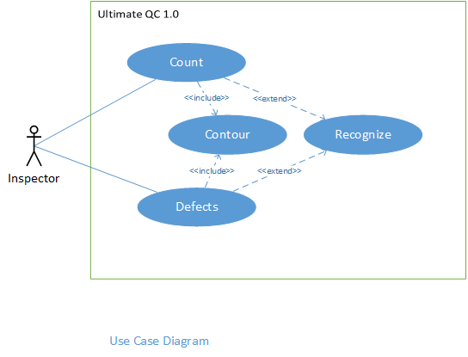
Requirements: Use Cases
Notes:
4. Requirements:
4.1. User stories implemented (one or more slides).
4.2. UML use cases and the use case diagram for the implemented use cases (one or more slides).
4.3. UML sequence diagrams for the implemented use cases.

Slide 6
Requirements: Use Cases
Actor: Inspector
UC002 – Count
The system shall count the produce in the image.
Constraints:
1. Usability:
No previous Training Time
On average the user should take no more than 5 secs to click count produce button.
2. Reliability:
0.10% probability of the system not being able to count all of the produce.
3. Performance:
The system should count the produce within 10 secs.
4. Supportability:
Image format should be supported by the system.
Notes:
4. Requirements:
4.1. User stories implemented (one or more slides).
4.2. UML use cases and the use case diagram for the implemented use cases (one or more slides).
4.3. UML sequence diagrams for the implemented use cases.

Slide 7
Requirements: Use Cases
Actor: Inspector
UC004 – Defects
The system shall detect defective produce, count them and give a percentage.
Constraints:
Usability:
No previous Training Time
On average the user should take no more than 5 secs to click find defects button.
Reliability:
0.10% probability of the system not being able to detect all of the defective produce.
Performance:
The system should detect the defective produce within 15 secs.
Supportability:
Image format should be supported by the system.
.
Notes:
4. Requirements:
4.1. User stories implemented (one or more slides).
4.2. UML use cases and the use case diagram for the implemented use cases (one or more slides).
4.3. UML sequence diagrams for the implemented use cases.

Slide 8
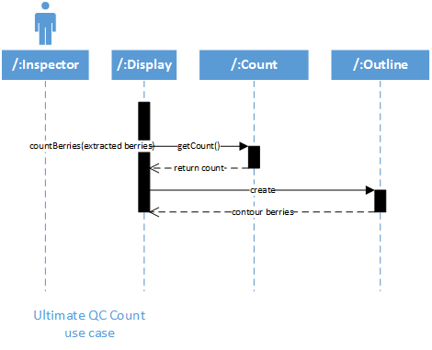
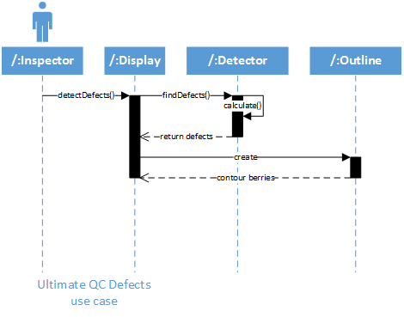
Requirements: Sequence Diagrams
Notes:
4. Requirements:
4.1. User stories implemented (one or more slides).
4.2. UML use cases and the use case diagram for the implemented use cases (one or more slides).
4.3. UML sequence diagrams for the implemented use cases.

Slide 9
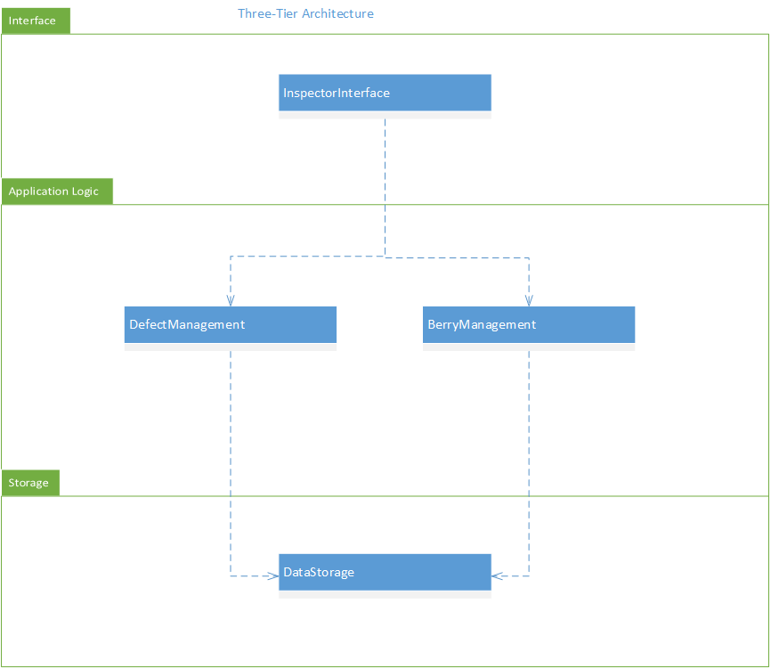
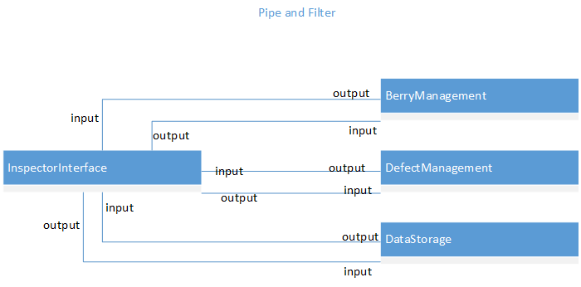
System Design: Architecture
Notes:
5. System design:
5.1. System decomposition; identify the architecture patterns used (one slide).
5.2. System deployment – h/w and s/w requirements (one slide).
5.3. Persistent data design (one slide).
5.4. Security/Privacy (one slide).

Slide 10
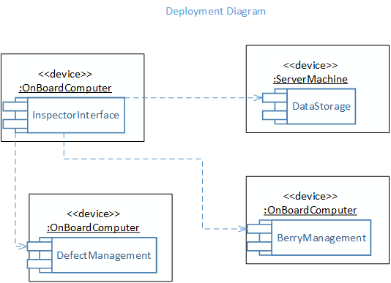
System Design: Deployment
The InspectorInterface subsystem is connected to the DataStorage subsystem so that any computer that has the system installed on it will have access to all of the same photos and reports.
The BerryManagement subsystem and the DefectManagement subsystem interact with the InspectorInterface subsystem.
Notes:
5. System design:
5.1. System decomposition; identify the architecture patterns used (one slide).
5.2. System deployment – h/w and s/w requirements (one slide).
5.3. Persistent data design (one slide).
5.4. Security/Privacy (one slide).

Slide 11
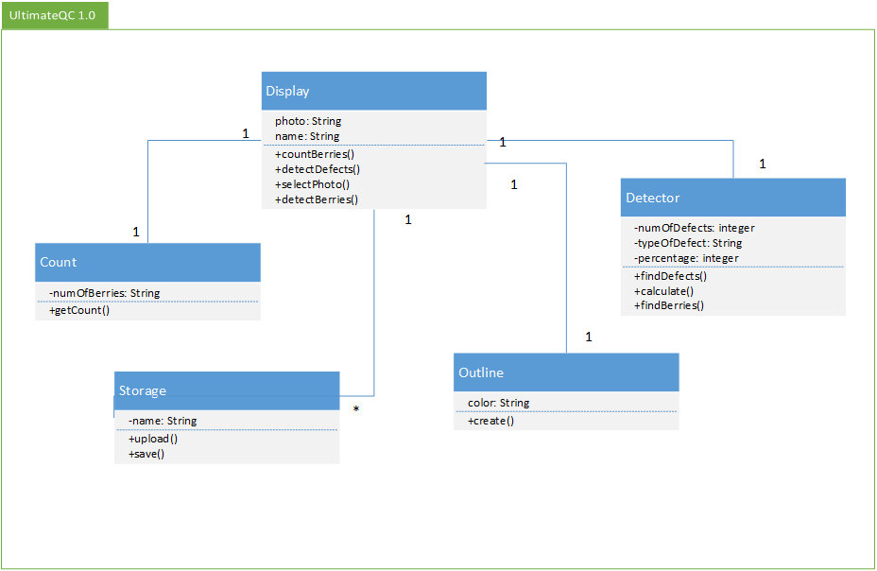
Class Diagram
Notes:
6. Detailed design:
6.1. Minimal class diagram. Identify the design patterns used (one or more slides).
6.2. State machine for the main control object or the most important object of the implemented uses cases (one or more slides).
6.3. Main algorithm used related to an implemented use case described above (one or more slides).

Slide 12
Main algorithm
UltimateQC{
filename = imgetfile;
berries = imread(filename);
%If no blueberries detected halt program
detector = objectDetector(‘blueberryDectector.xml’);
if no blueberries detected
imshow(berries);
title('There are no blueberries detected in image');
return
end
%extract berries and defects
maskberries = extractberries(berries);
maskdefect = extractimmatureberries(berries);
[bpos, bcount] = countblueberries(maskberries);
[ipos, icount] = countdefects(maskdefect);
%display image
imshow(berries);
%outline berries and defects
circle(bpos, cyan);
circle(ipos, red);
percent = (icount/bcount)*100;
title('Number of berries:’ bcount ‘Number of immature:’ icount ‘Defects:’ percent '%');
}
Notes:
6. Detailed design:
6.1. Minimal class diagram. Identify the design patterns used (one or more slides).
6.2. State machine for the main control object or the most important object of the implemented uses cases (one or more slides).
6.3. Main algorithm used related to an implemented use case described above (one or more slides).

Slide 13
Test Suites and Test Cases
Test Suite TUC004
Purpose: To test the functionality of use case: UC004 – Defects
Test case 1:
Purpose To test that the system counts the detected immature blueberry defects, outlines them in red, and gives the percentage in an image with defects.
Precondition 1. MATLAB must be running and Ultimate QC main program must be open.
2. The user clicks on the run button.
Input The user selects a blueberry image that contains immature blueberries.
Expected Output The system displays the image with immature blueberries outlined in red and returns the count and percentage.
Notes:
7. Test Suites and Test Cases (one sunny day and one rainy day) for the use case represented in part (5) above (2 slides).
7.1 One sunny day and one rainy day for the implemented use cases (one or more slides).
7.2 Automated test scripts for the implemented use cases (one or more slides).

Slide 14
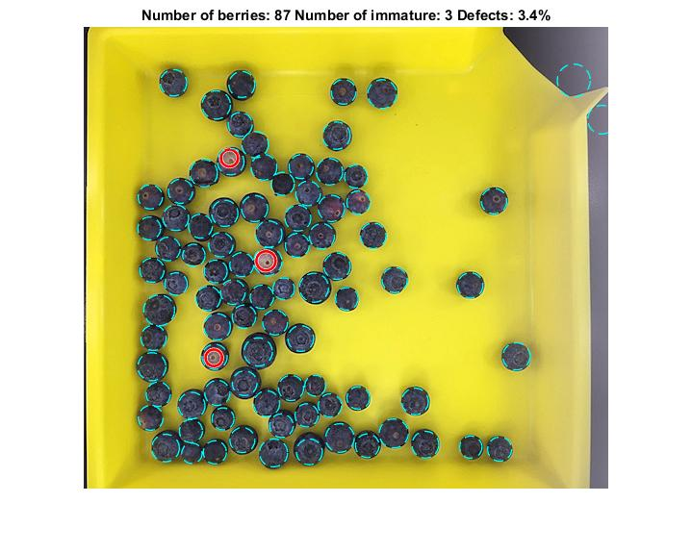
Test Suites and Test Cases
Notes:
7. Test Suites and Test Cases (one sunny day and one rainy day) for the use case represented in part (5) above (2 slides).
7.1 One sunny day and one rainy day for the implemented use cases (one or more slides).
7.2 Automated test scripts for the implemented use cases (one or more slides).

Slide 15
Test Suites and Test Cases
Test Suite TUC004
Purpose: To test the functionality of use case: UC004 – Defects
Test case 2:
Purpose To test that the system does not detect immature blueberry defects in an image with no defects.
Precondition 1. MATLAB must be running and Ultimate QC main program must be open.
2. The user clicks on the run button.
Input The user selects a blueberry image that contains no immature blueberries.
Expected Output The system displays the image with no blueberry outlined in red and the immature defect count and percentage equal to zero.
Notes:
7. Test Suites and Test Cases (one sunny day and one rainy day) for the use case represented in part (5) above (2 slides).
7.1 One sunny day and one rainy day for the implemented use cases (one or more slides).
7.2 Automated test scripts for the implemented use cases (one or more slides).

Slide 16
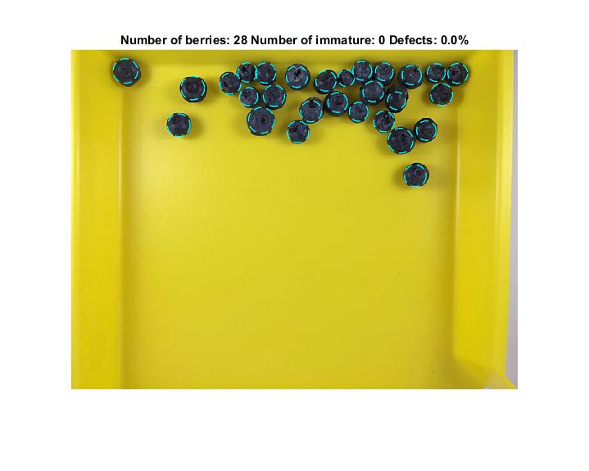
Test Suites and Test Cases
Notes:
7. Test Suites and Test Cases (one sunny day and one rainy day) for the use case represented in part (5) above (2 slides).
7.1 One sunny day and one rainy day for the implemented use cases (one or more slides).
7.2 Automated test scripts for the implemented use cases (one or more slides).

Slide 17
Summary
In conclusion, I was able to develop a system that can identify blueberries in an image, count the blueberries, and detect immature blueberries, and give a percentage of how much of the blueberries are defective.
mkell008@fiu.edu
Questions?
Thank You!
Notes:
Summarize your contribution
Include your contact information
Ask if anyone has any questions for you.
Thank your audience

